Slide 2


Analysis of FPAs in the LHC RB circuit
Christoph Obermair, TE-MPE-CB Lukas Felsberger, TE-MPE-MI Franz Pernkopf, TU-Graz Andrea Apollonio, TE-MPE-CB Daniel Wollmann, TE-MPE-CB

Slide 3
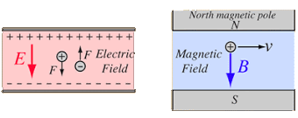
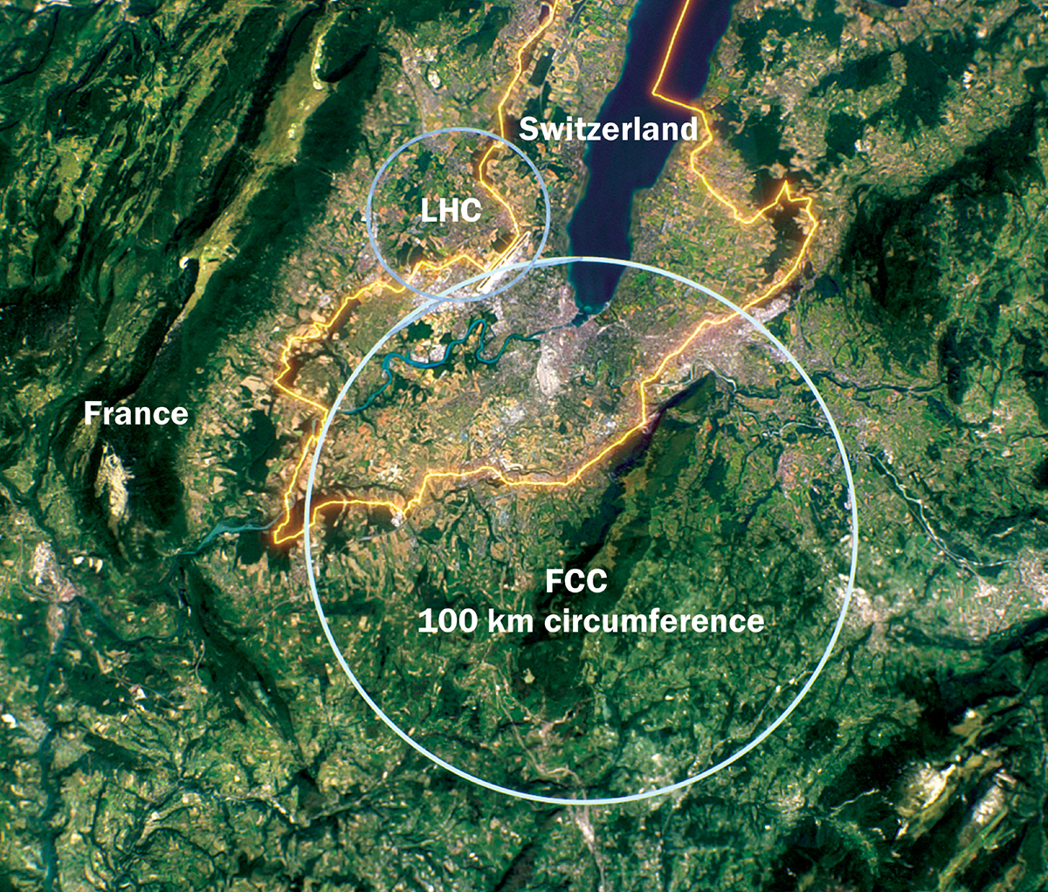
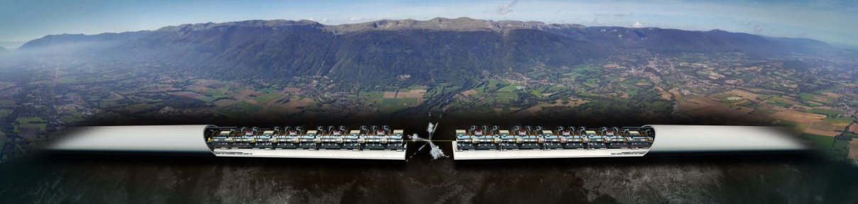
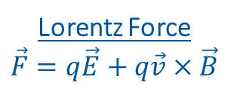
Introduction to Accelerators
Principle: Accelerate particles with electric field, and analyze collissions with target.
Types:
Linear accelerators - Linear accelerator 4 (Linac4)
Limitation to high collission energy is electric field
Breakdowns can destry radio frequency cavities
Circular accelerators - Large Hadron Collider (LHC)
Limitation to high collission energy is electric field
Quenches can destroy magnets
Current LHC status: LHC page 1
Lorentz Force
$$\vec{F}=q\vec{E}+q\vec{v}×\vec{B}$$
CLIC concept image

Slide 4
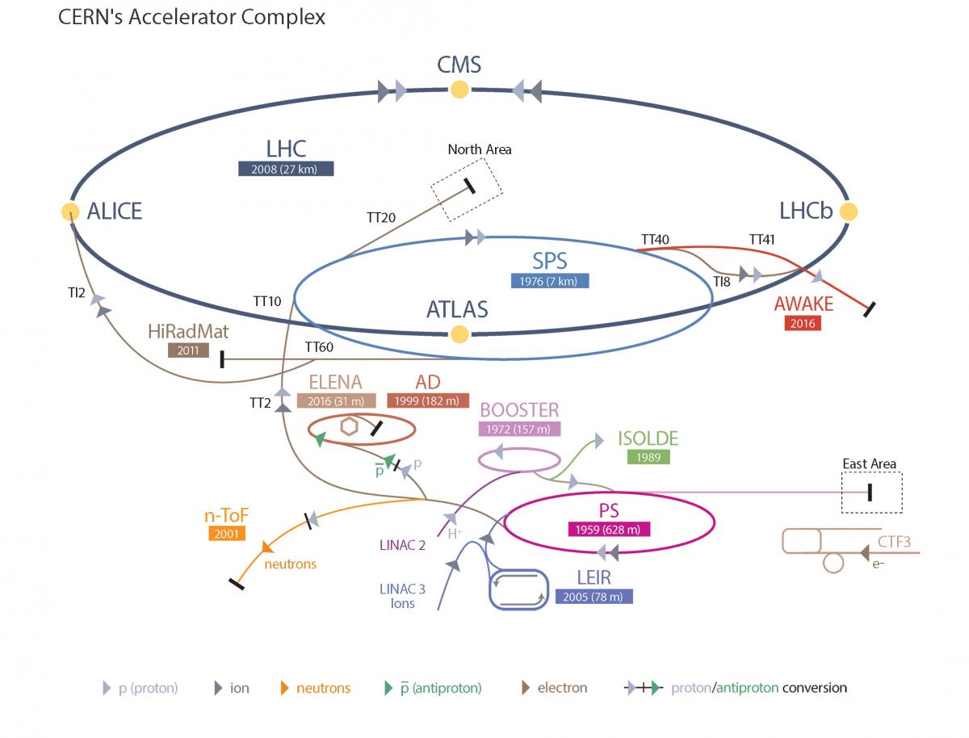
Large Hadron Collider - LHC
LHC Facts
Cost of the LHC | 4332 MCHF
Length | 26 659 m
Dipole operating temperature | -271.3°C
Cost per magnet | ~ 1 MCHF
Number of main dipoles | 1232
Power consumtion | 1.3 TWh/a
Number of circuits | 8
Stored energy per circuit | 1.1 GJ (380-ton TGV @ 50km/h)
1/13/2023

Slide 5
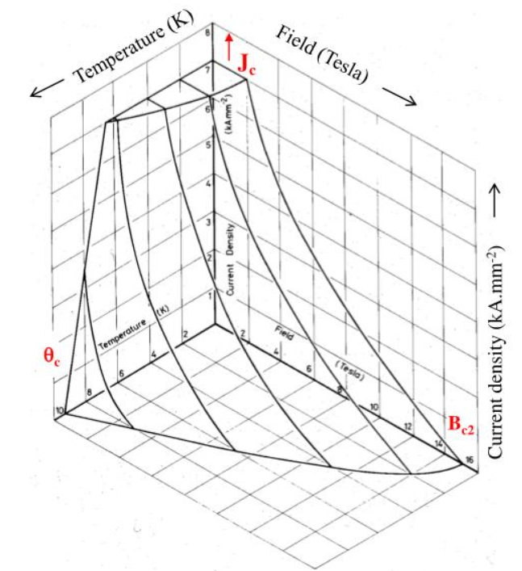
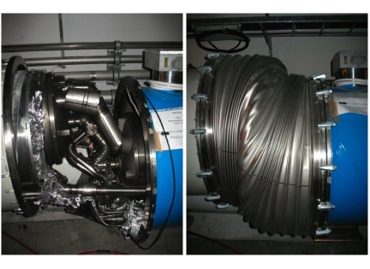
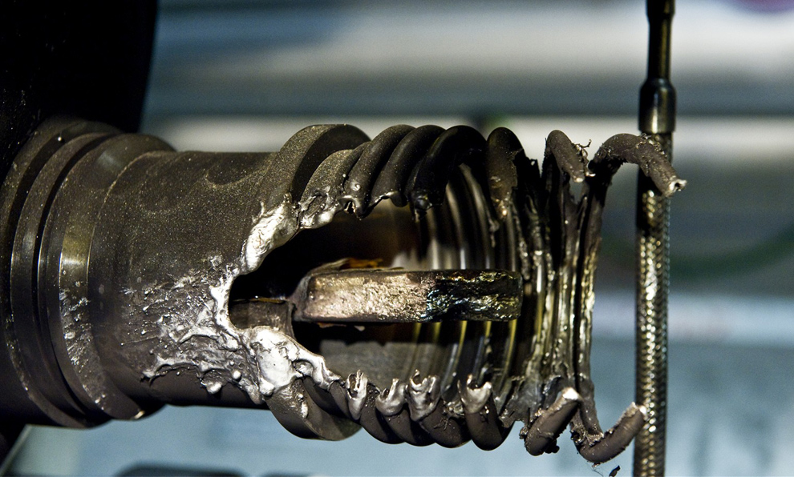
Quench Protection
Quench is biggest threat to LHC dipole magnets
Different types of quench:
Primary quench
Secondary quench: GHe propagation, EM disturbance,..
Quench Protection:
Bypass Diode
Quench Heater
Quenches with destructed magnets:
2008 (~100 destroyed magnets – splice opened)
2021 HWC (1 destroyed magnet - interturn short in coil)
Possible precursor detected 1 month before
Precursor: Oscillation in U_Diode Voltage
Goal: Further precursors?
Critical surface NbTi

Slide 6
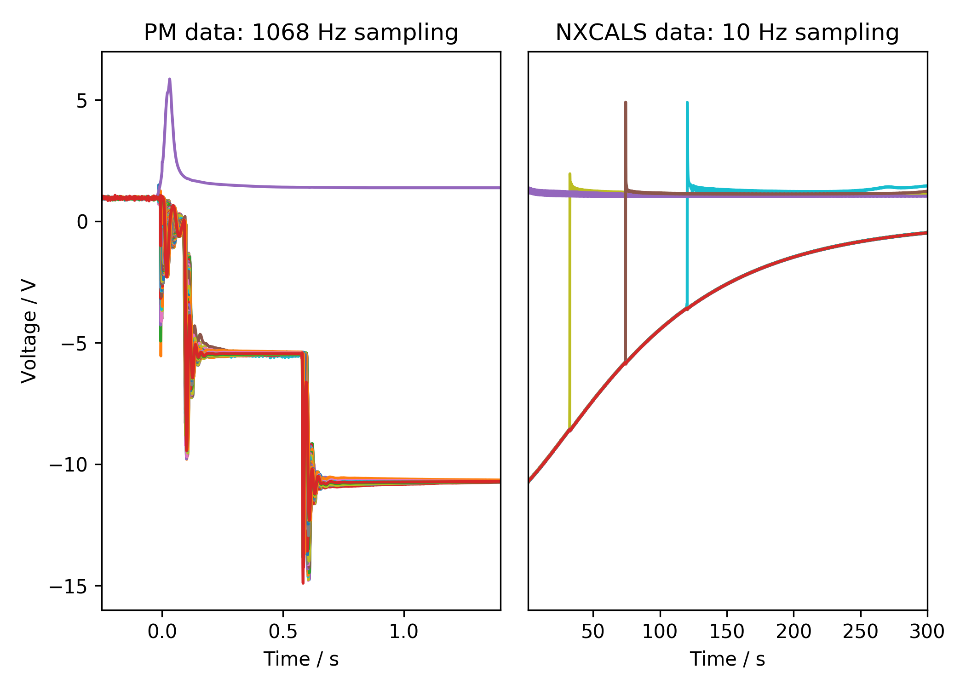
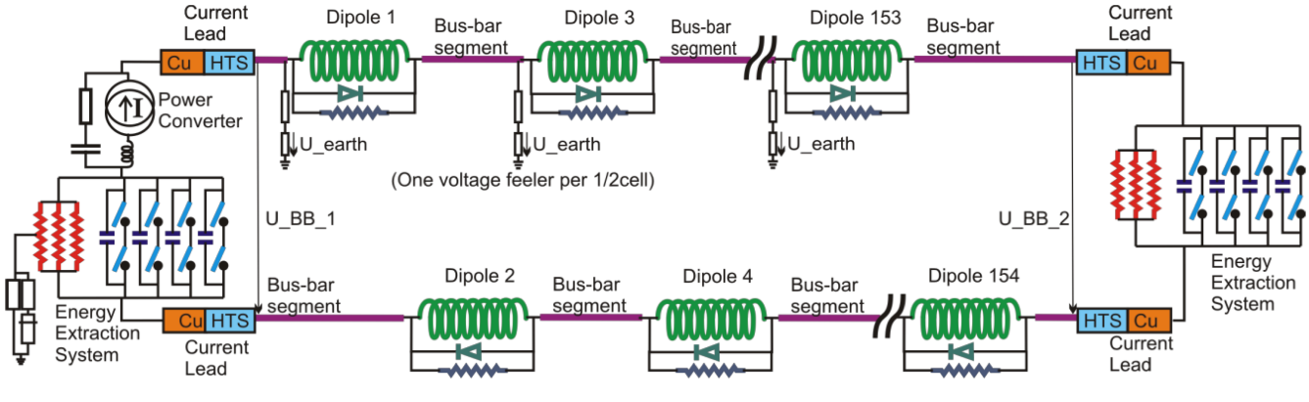
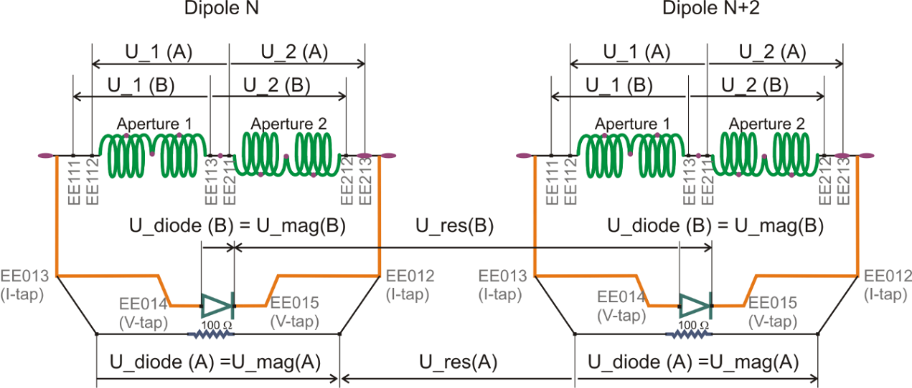
Quench Protection: U-Diode
Analyzed Area
Analyzed Area
2nd EE switch off
Secondary quench
1st EE switch off
PC Switch off

Slide 7
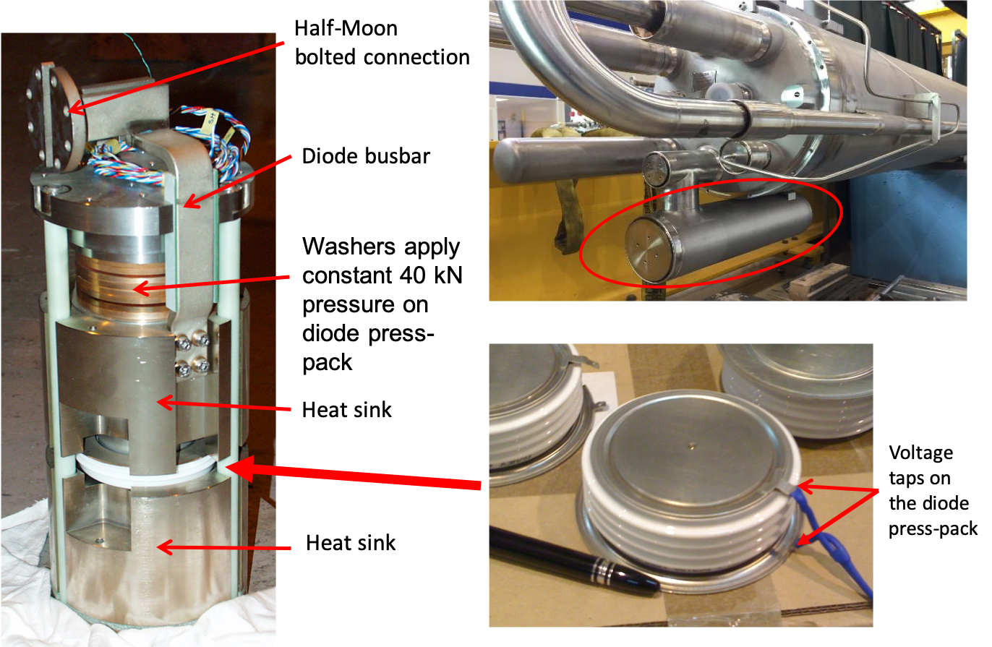
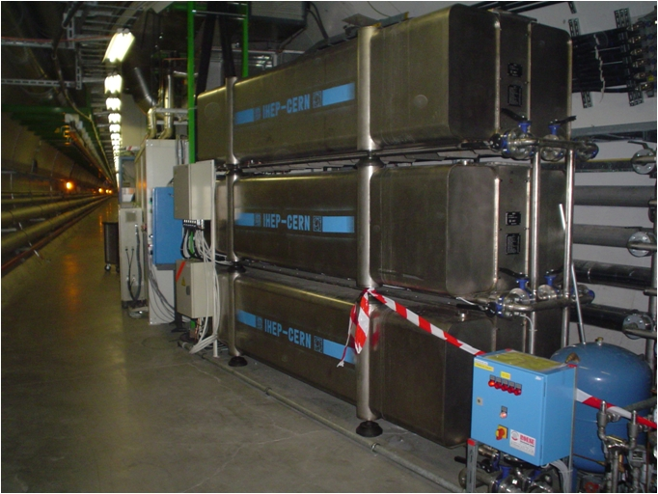
Hardware
Diode
Energy Extraction Resistance

Slide 8
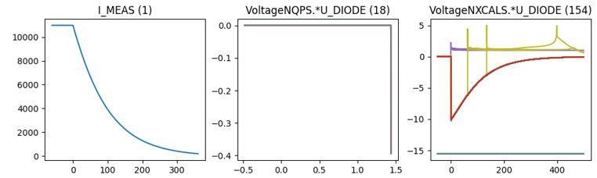
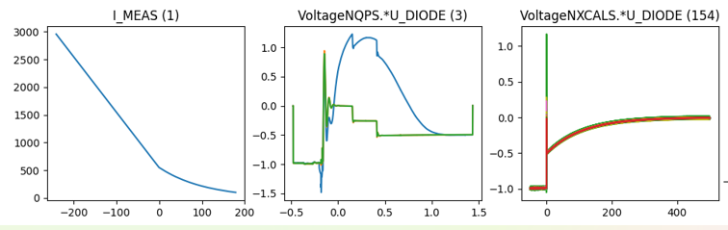
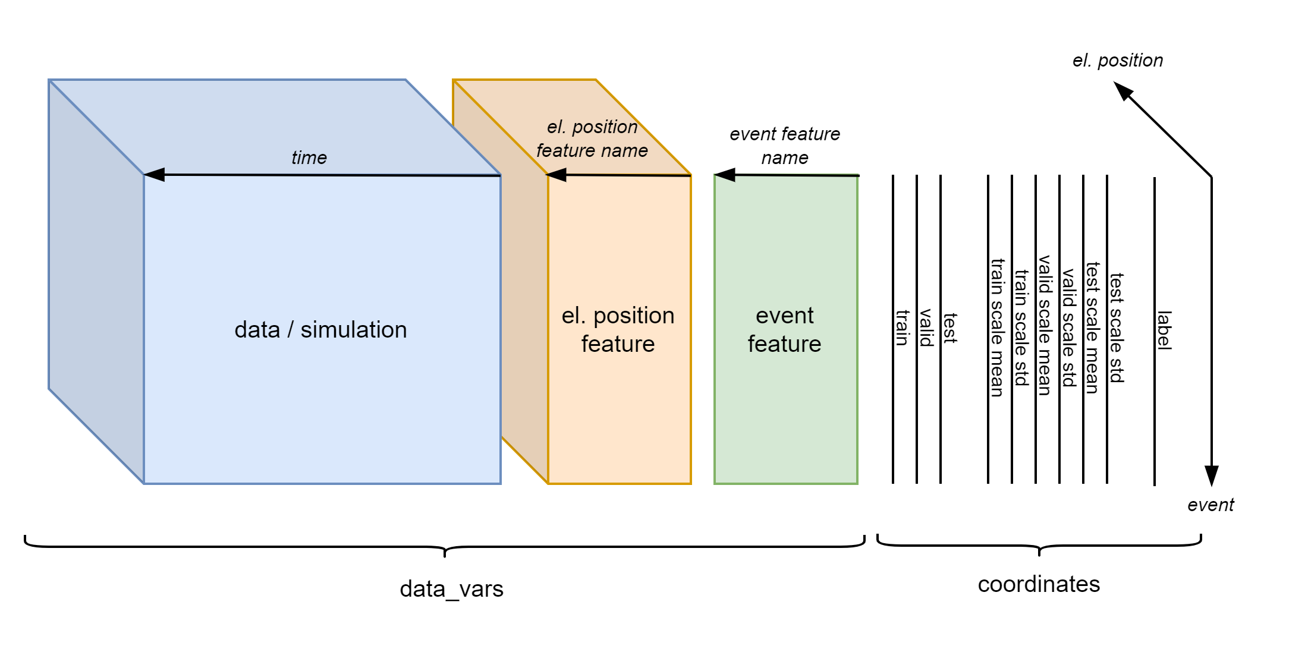
Existing Database Overview
Data overview
Filtered events
 | Signal | 2014-2020 | 2021 | # events
Real Data | U_DIODE_NXCALS | P | P | 867
 | U_DIODE_PM | P | P | 629
 | I_MEAS | P | P | 896
 | U_QSO, U_1, U_2 | P | P | 893
 | I_EARTH_PCNT | P | P | 895
 | I_EARTH | P | P | 629
 | I_HDS, U_HDS | P | P | 896
 | EEUDumpResPM | P | P | 896
Simulations | V(0v_magf*) | P | P | 875
 | I(r1_warm) | P | P | 875
 | V(10,11), V(18,19) | P | P | 875
#events |  | 267 | 629 | 560/896

Slide 9
What are the expected oscillations after a quench?

Slide 10
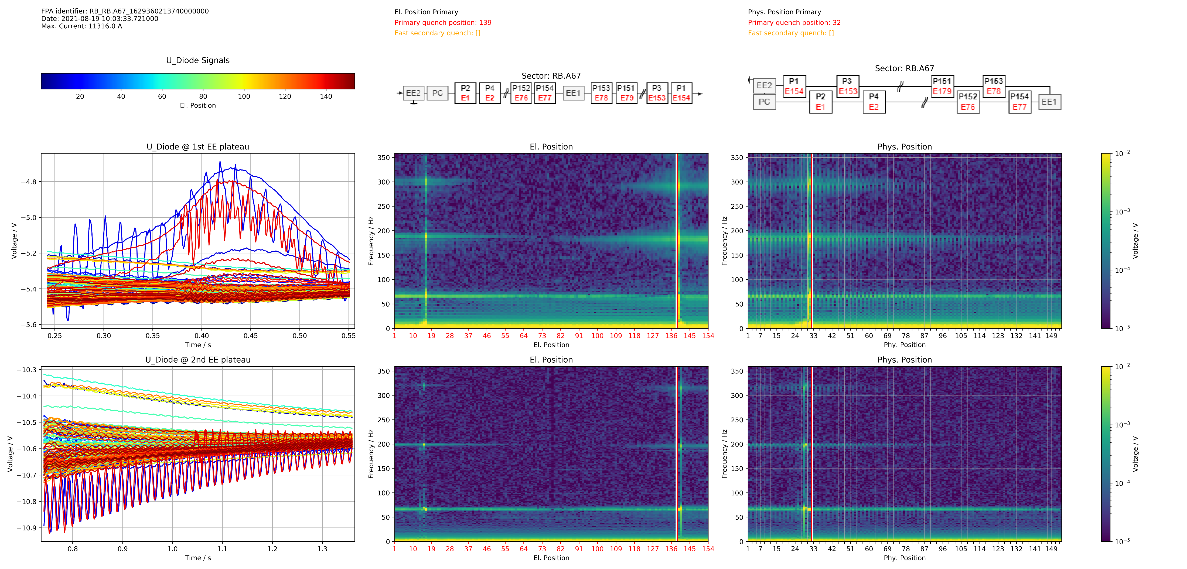
Position Frequency (FP) Map

Slide 11
Sort Magnets differently

Slide 12
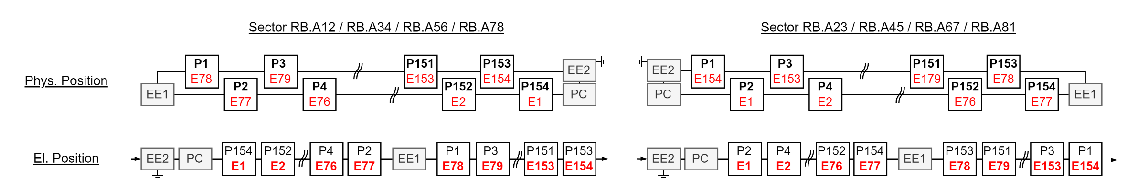
El. Vs Phys. Position

Slide 13
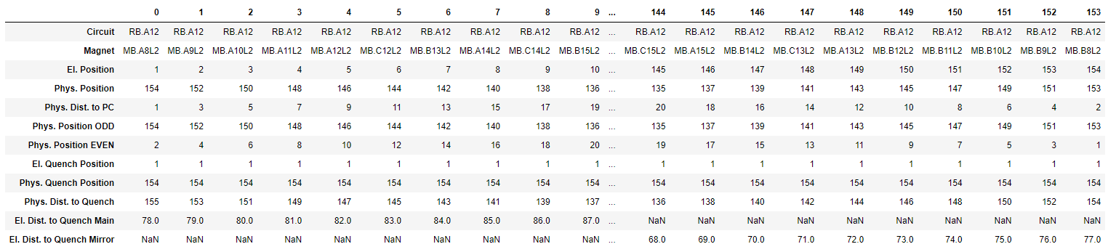
ODD: El. Vs Phys. Position Table

Slide 14
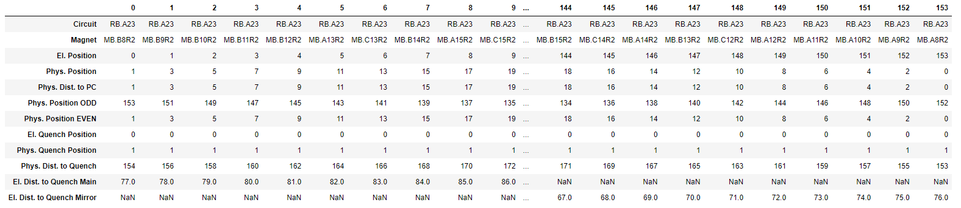
EVEN

Slide 15
How are the FP-maps composed?

Slide 16
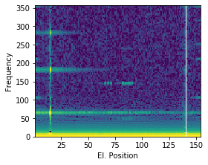
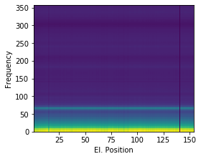
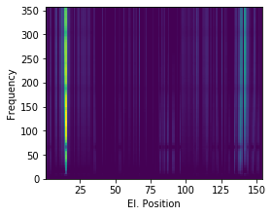
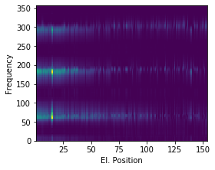
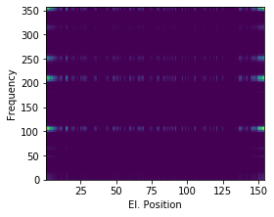
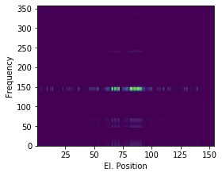





How are the FP-maps composed?
$$≈$$
$$+$$
$$+$$
$$+$$
$$+$$
Common Oscillation
Physical Propagation
Electrical Propagation
Power Converter
Energy Extraction
Event:
RB_RB.A78_1617170255140000000
2021-03-31 07:57:35.120000

Slide 17
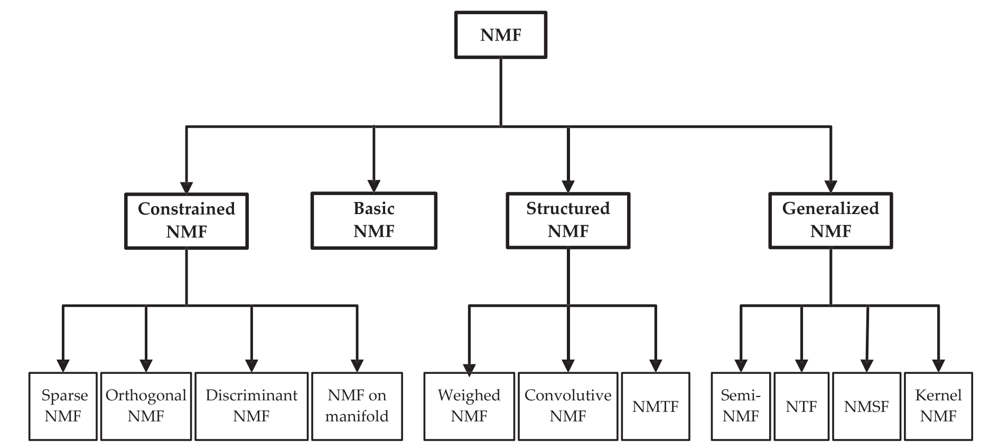
Non-Negative Matrix Factorization

Slide 18
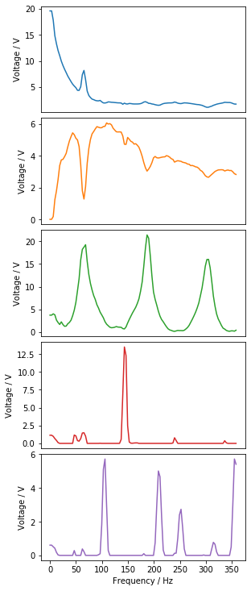
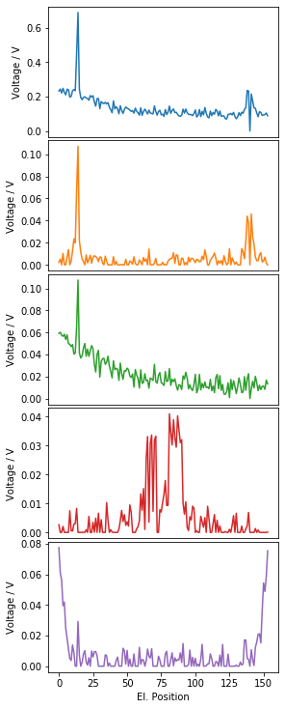
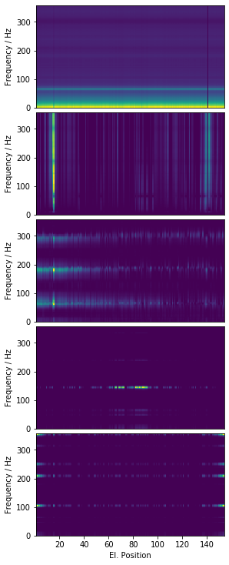
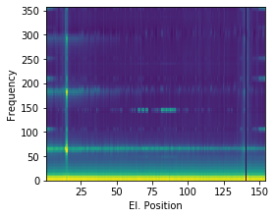
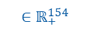
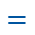
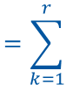
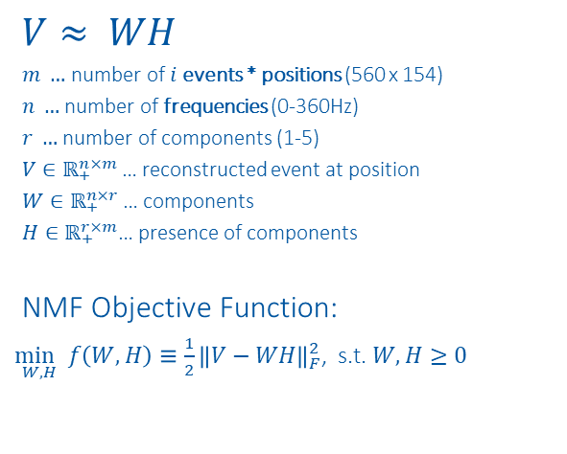

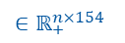
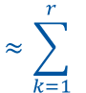
NMF on Position Frequency Maps
$$V≈ WH$$
$m …$ number of $i$events * positions (560 x 154)
$n …$ number of frequencies (0-360Hz)
$r …$ number of components (1-5)
$V∈ℝ_{+}^{n×m}$… reconstructed event at position
$W∈ℝ_{+}^{n×r}$… components
$H∈ℝ_{+}^{r×m}$… presence of components
NMF Objective Function:
$\underset{W,H}{\min{ }}f\left(W, H\right)≡\frac{1}{2}{\left\|V−WH\right\|}_{F}^{2}$, s.t. $W, H≥0$
$$V_{:,i:i+154} ≈ \sum_{k=1}^{r}{{ W}_{:,k}{ H}_{k,i:i+154} =}\sum_{k=1}^{r}{{ WH}_{k, i:i+154} = {WH}_{i:i+154}}$$
$${∈ℝ}_{+}^{n×154}$$
$${ ∈ℝ}_{+}^{n}$$
$${ ∈ℝ}_{+}^{154}$$
$${∈ℝ}_{+}^{n×154}$$
$${∈ℝ}_{+}^{n×154}$$
$$≈\sum_{k=1}^{r}{ }$$
$$⋅$$
$$=\sum_{k=1}^{r}{ }$$
$$=$$
$$⋅$$
$$⋅$$
$$⋅$$
$$⋅$$
https://www.nature.com/articles/44565
https://proceedings.neurips.cc/paper/2000/file/f9d1152547c0bde01830b7e8bd60024c-Paper.pdf

Slide 19
2021-03-31 07:57:35.120000

Slide 20
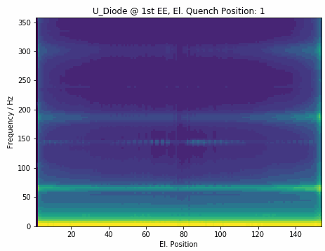
1st EE Component Generalization

Slide 21
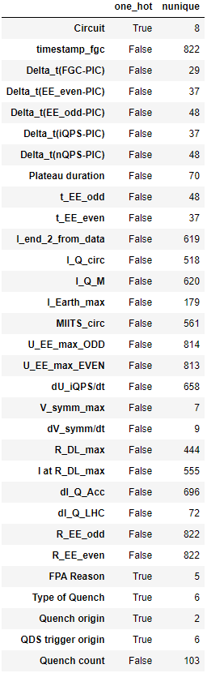
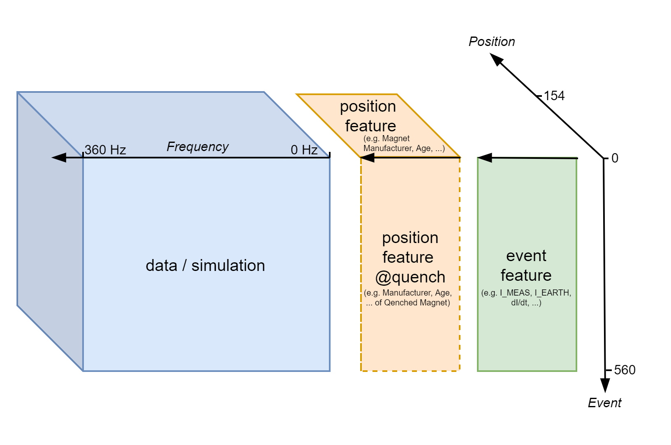
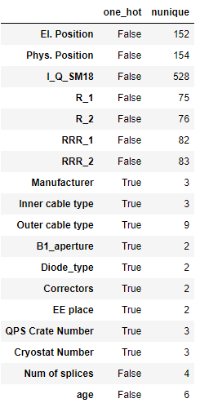
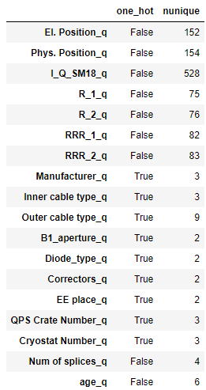
Context Data Overview
Event Context
Position Context
Quench Position Context

Slide 22
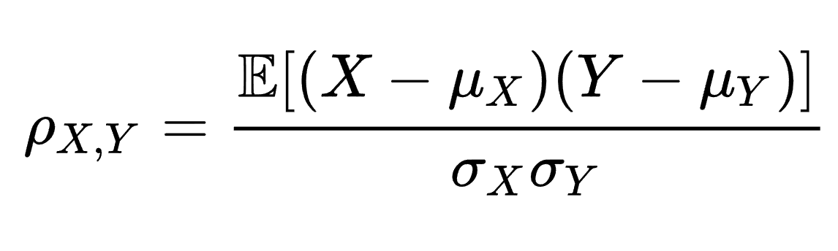
Correlation

Slide 23
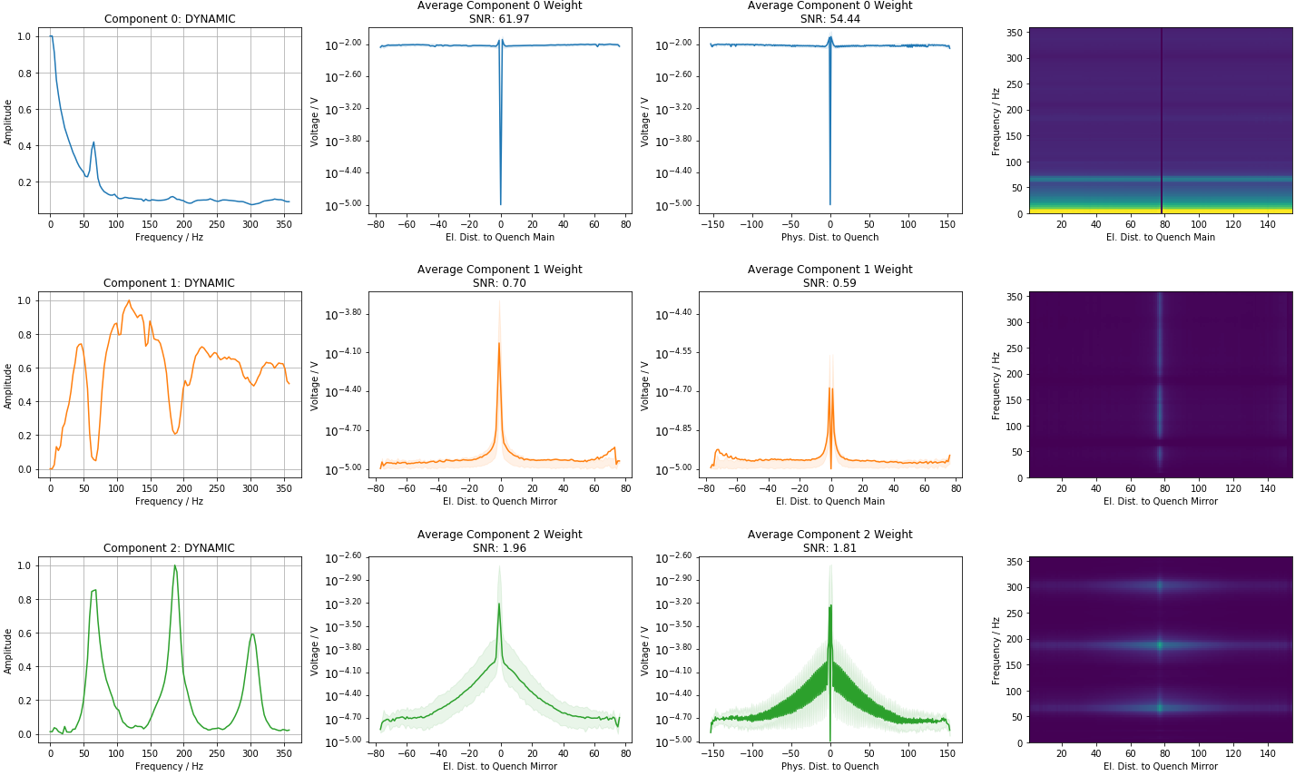
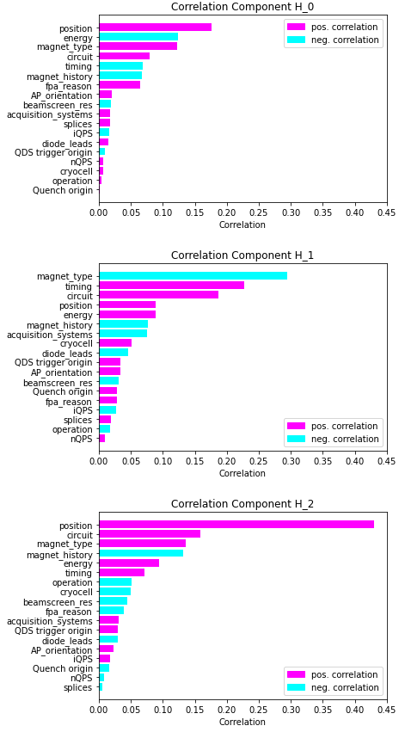
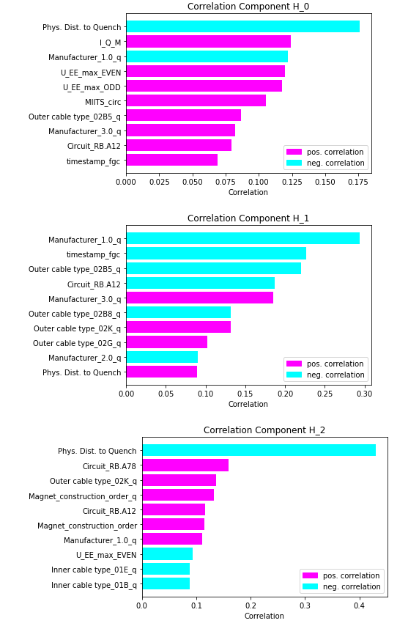
1st EE: Average Weight of Components

Slide 24
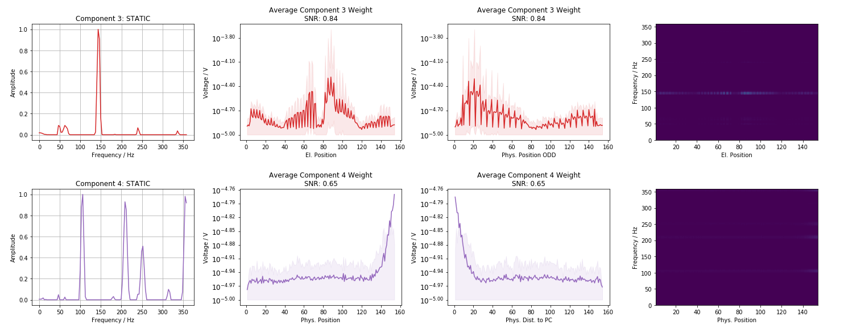
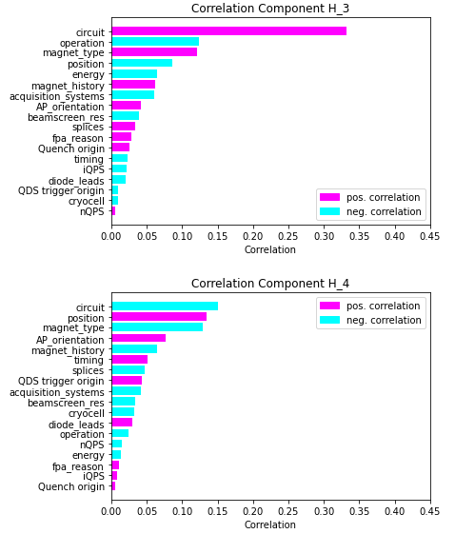
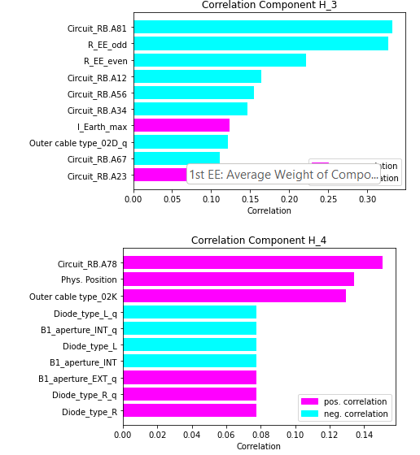
1st EE: Average Weight of Components

Slide 25
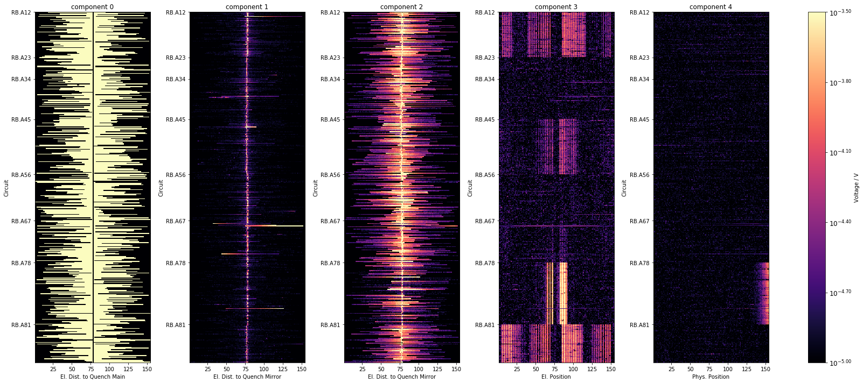
1st EE: Component distribution over Sector
All events from 2021, excl. events with fast sec. quenches

Slide 26
1st EE Correlation

Slide 27
Component Overview
Component Number | Dominant Frequencies [Hz] | Source Direction | Positional Correlation to | Event Correlation to
1 | Offset (low frequency) |  | Manufacturer, Circuit
2 | Offset (high frequency) | Quench | Manufacturer, Circuit, R_BS
3 | 65, 184, 302 | Quench | Circuit
4 | 143 | QPS Crate | Circuit, R_BS | R_EE, I_MEAS
5 | 106, 209, 252, 355 | Power Converter RB.A78 | Circuit

Slide 28


1st EE: Component 3: QPS Crate Grid

Slide 29

Plot features with high correlation

Slide 30



Plot features with high correlation

Slide 31

Plot features with high correlation

Slide 32

Plot features with high correlation

Slide 33

Plot features with high correlation

Slide 34




Plot features with high correlation

Slide 35
1st EE Component Weight Prediction

Slide 36

Predict Component Weights
Event Context
Position Context
Quench Position Context

Slide 37


Context Importance

Slide 38
1st EE Component Correlation

Slide 39

Plot features with high correlation

Slide 40

Plot features with high correlation

Slide 41

Plot features with high correlation

Slide 42

Energy component 2

Slide 43
2nd EE: Component Generalization

Slide 44

2nd EE: Average Weight of Components

Slide 45

2nd EE: Average Weight of Components

Slide 46

2nd EE: Component distribution over Sector
All events from 2021, excl. events with fast sec. quenches

Slide 47

Recreate Events

Slide 48
Snapshots

Slide 49

Snapshots: 1st EE 2022-03-11 17:02:12

Slide 50

Snapshots 1st EE: Distribution over Sector
47/64 events successfully downloaded.

Slide 51

Snapshots 1st EE: Distribution over Current
47/64 events successfully downloaded.

Slide 52

Snapshots: 2nd EE 2022-03-11 17:02:12

Slide 53

Snapshots 2nd EE: Distribution over Sector
47/64 events successfully downloaded.

Slide 54

Snapshots 2nd EE: Distribution over Current
47/64 events successfully downloaded.

Slide 55

Next Steps
Find normal components -> optimize regularization + hyperparameters for NMF
Improve NMF:
Split in trainable non-trainable components
Sanity Check:
Check NMF components Snapshots
Component distribution:
Distribution over sector, sec. quench type (training, QH trigger), time, intercoil short sector
Isolate normal NMF components:
Which el. components are causing them
Fix normal NMF components (no update in $W$)-> Find anomaly component:
Which component occurs in faulty magnets
How does component weight change over time

Slide 57

1st EE 2021-03-31 07:57:35.120000

Slide 58

Simulation 1st EE 2021-03-31 07:57:35.12

Slide 59

2nd EE 2021-03-31 07:57:35.120000

Slide 60

Simulation 2nd EE 2021-03-31 07:57:35.12

Slide 61
Further NMF examples

Slide 62

RB.A23 2021-03-09 07:39:33

Slide 63

1st EE RB.A23 2021-03-09 07:39:33

Slide 64

2nd EE RB.A23 2021-03-09 07:39:33

Slide 65








NMF Examples
$$≈\sum_{k=1}^{r}{ }$$
$$⋅$$
$$=\sum_{k=1}^{r}{ }$$
$$=$$
$$⋅$$
$$⋅$$
$$⋅$$
$$⋅$$

Slide 66





NMF Examples
$$≈\sum_{k=1}^{r}{ }$$
$$⋅$$
$$=\sum_{k=1}^{r}{ }$$
$$=$$
$$⋅$$
$$⋅$$
$$⋅$$
$$⋅$$

Slide 67
Sanity Checks

Slide 68




Kirchhoff
$$−U_{BB_{1}}+U_{BB_{2}}+\sum_{n=1}^{154}{U_{Diode}\left(n\right)}=0$$
Challenges: (1) Sampling (2) Time-alignment

Slide 69


FFT sanity check

Slide 70

Data - Simulation

Slide 71
Special Events

Slide 72
Intercoil Short

Slide 73

Intercoil Precursor

Slide 74

Diode Short

